Slide 1

Pollák Csengő
The music of the future

Slide 2
Project Concept & Inspiration
Project Selection:
Chose a topic related to education
Aimed to bring tangible change to school life
Idea Origin:
Inspired by a team member’s suggestion
Proposed a web application to enhance the school atmosphere
Pollák Bell Concept:
Replacing the traditional school bell
Introducing a dynamic, varied sound system
Designed to make breaks more engaging and break monotony

Slide 3
Purpose of the Software
Seamless Integration & User-Friendly Design:
Strengthens the sense of community
Adds excitement and innovation to the educational environment
Interactive Student Participation:
Students vote for their favorite songs
Determines the “Ringtone of the Month”
Introduces a dynamic rotation of bell sounds throughout the school year
Innovative Web Platform:
Accessible on both mobile devices and computers
Ensures broad usability and convenience
Positive Impact on School Life:
Brings freshness and enjoyment to daily routines
Encourages student engagement in a fun and interactive way
Contributes to student well-being and school experience

Slide 4
Patrik Jani’s Contributions
Figma & Template-Based Frontend Design
Frontend Development & Testing:
Implementation and testing of the Home Page
Backend Development:
Defining API endpoints
Writing the Prisma schema
Creating the ER diagram
Backend Implementation & Testing:
Server-side rendering
APIs for:
TV content
User management
Songs & Pending Songs
Project Documentation:
Overview & Summary
Bibliography & References

Slide 5
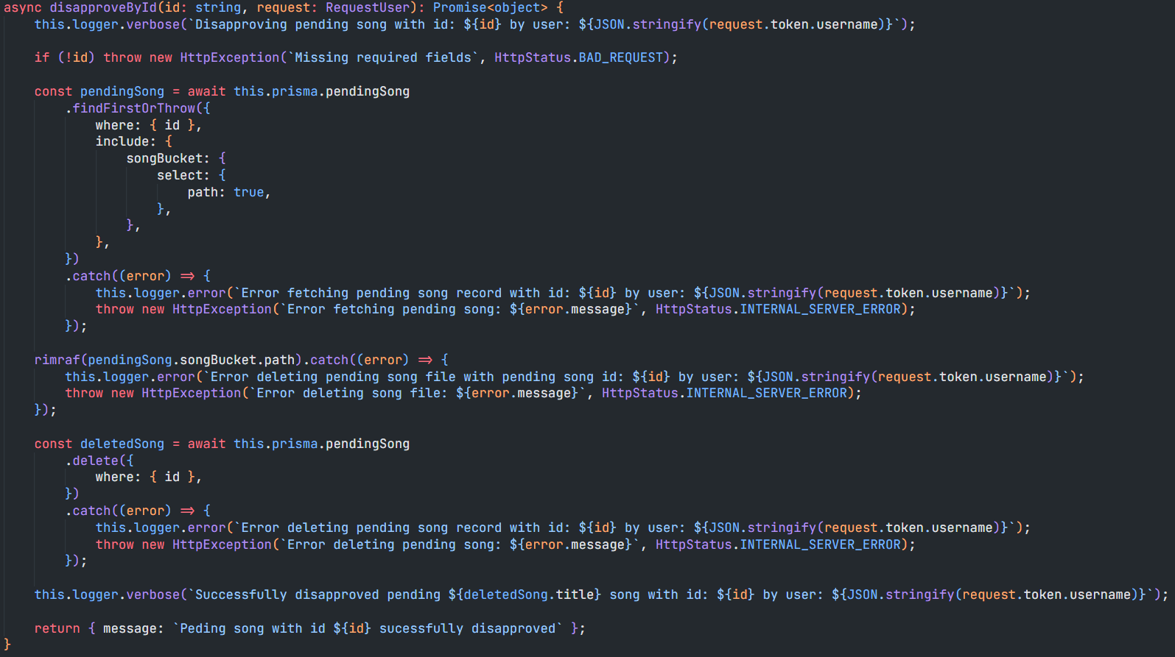
Patrik Jani’s Highlighted Algorithm
Pending Songs Approval system:
If approved: transfers the pending song from the Pending Songs table to the Songs table.
If disapproved: deletes the record from the Pending Songs table along with the mp3 file.

Slide 6
Who is it for and why?
Primarily designed for schools
Aims to improve students' school experience
Fosters a positive and community-oriented atmosphere
Students vote for their favorite songs
Adds a fun and interactive element to everyday school life
Students vote for the “Ringtone of the Month”
Ensures fresh and engaging auditory experience

Slide 7
Target groups and benefits
Schools:
Helps create a livelier and more cohesive community atmosphere.
Students:
Gives them the opportunity to influence the daily mood of the school by voting for their favorite songs.
Teachers and staff:
Creates a more dynamic and inspiring environment that fosters learning and social relationships.

Slide 8
Competitors
Bella-Iskolacsengő:
Customizable bell sound selection
Convenient ringing schedule management via app
Personalized ringtone choices
User-friendly interface for easy interaction
Gipen Iskolacsengő:
Modern and minimalist solution
Allows schools to choose their own bell sound
Provides voting opportunity for students
Simple and clean interface
Quick and efficient use for students and school staff

Slide 9
Máté Barna’s Contributions
Frontend Development:
Integrated a YouTube embed to the snipper
Login and register pages
Tests for login, register, tv and the snipper page
Layouts for authentication pages
Project Documentation:
Documentation introduction
User documentation
Installation steps
Administration guide
Backend Development:
Writing logic for YouTube parsing
Writing REST endpoints
Voting service, module and controller
Tests for modules
Gant diagram
Continuous integration (and some deployment for testing)
Setup scripts for deployment on windows

Slide 10
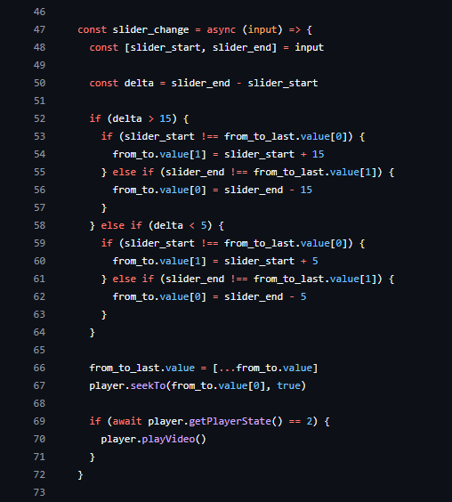
Máté Barna’s Highlighted Algorithm
Frontend two-way slider with a limiter:
Since the maximum length of the bell's uploaded must be between 5-15 seconds, a two-way slider had to implemented.
When one is dragged over the maximum allowed interval then the counterpart should follow.
This results in a neat and rather reactive slider acknowledging the user of the maximum lengths.

Slide 11
Core Technologies
TypeScript:
Statically typed JavaScript extension
Enhances code maintainability and readability
Integrates well with Vue
NestJS:
Progressive Node.js framework using TypeScript
Modular architecture for scalable backend applications
Vuetify:
Material Design component framework for Vue.js
Pre-designed components following Google Material Design guidelines
Playwright:
End-to-end testing framework developed by Microsoft
Simulates user interactions to ensure expected application behavior
Vite:
Next-generation frontend build tool
Instant hot module replacement and fast builds
Prisma:
Open-source ORM for Node.js and TypeScript
Type-safe query builder and intuitive data modeling

Slide 12
Development environment
WebStorm:
Developed by JetBrains
Deep integration with JavaScript frameworks like Vue
Intelligent code completion and robust debugging
Advanced features compared to Sublime Text
Docker and Docker-compose:
Containerization for consistent development environments
Simplifies multi-container application management
Lighter and faster containerization compared to Vagrant
Visual Studio Code (VS Code):
Free and open-source code editor
Extensive plugin ecosystem
Supports many programming languages and frameworks
Features IntelliSense, built-in Git support, and terminal
GitHub:
Combines code hosting, version control, and collaboration, avoiding tool-switching like Jira requires
Pull requests, code reviews, and CI/CD tools made GitHub ideal for us
GitHub's integrations and community surpass Jira's project focus

Slide 13
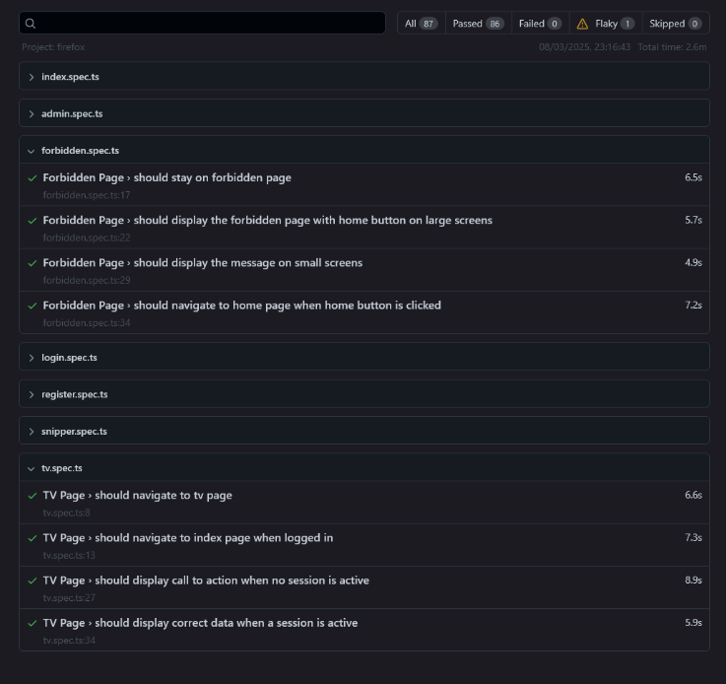
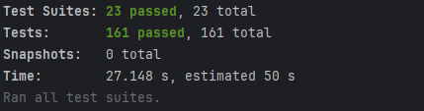
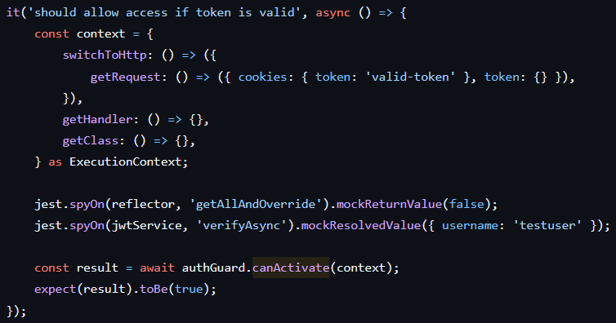
Unit and E2E Testing
Frontend Tests
Backend Tests

Slide 14
Gyula Tamáskovits' Contributions
Frontend Development & Testing:
Pages implemented, tested and connected to backend:
Admin Page
Tv Page
Containerized frontend with docker
Implemented docker-compose for frontend
Added continuous integration with Github Actions
Project Documentation:
Developer documentation
Power Point Presentation
Backend Implementation & Testing:
Defined API endpoints
APIs implemented and tested:
Auth API
Songs API
Tested server-side rendering
Services implemented and tested:
Auth Guard
Role Guard
File validator
Containerized backend with docker
Implemented docker-compose for backend
Added continuous integration with Github Actions

Slide 15
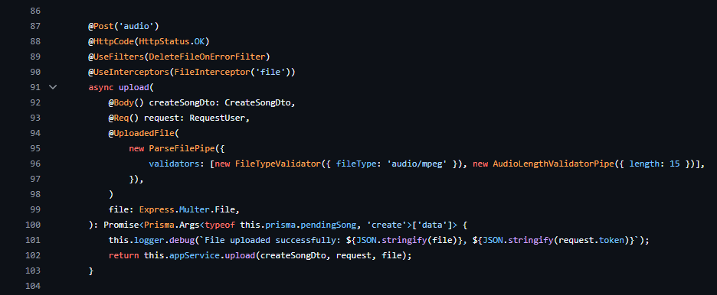
Gyula Tamáskovits' Highlighted Algorithm
Uploaded file validator and uploader:
It checks if the uploaded file is an audio file of type 'audio/mpeg' and ensures that its duration does not exceed 15 seconds.
If the file fails validation, the it deletes the uploaded file.
If the validation is successful, it handles the file upload process, logging the success and stores the validated file data.

Slide 16
Thank you!
Made by: Tamáskovits Gyula, Jani Patrik, Barna Máté

